Slide 1
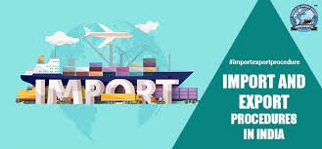
Trade statistics of India for Import and export of commodities from 2010-2018
presented by-
Name-D.Sai Sujan
University reg.no-9919004070

Slide 2
Subject
Importing means buying foreign goods and services by citizens, businesses and government of a country. No matter, how they are sent to the country. They can be shipped, sent it by e-mail, or even hand carried in personal luggage on a plane. A country importing more than it’s export, runs a trade deficit. Whereas, a country importing less than it’s exports, create a trade surplus.
Exporting means goods and services which are produced in one country are purchased in another country. It is produced domestically and sold to someone in a foreign country. Most countries want to increase their exports as it increases the GDP of the country.
In India At the level of Central Government it is administered by the Ministry of Commerce and Industry.
Prior to the 1991 economic liberalization , India was a closed economy due to the average tariffs exceeding 200 percent and the extensive quantitative restrictions on imports. Foreign investment was strictly restricted to only allow Indian ownership of businesses. Since the liberalization, India's economy has improved mainly due to increased foreign trade

Slide 3
Data
HS code - HS stands for Harmonized System. It was developed by the WCO (World Customs Organization) as a multipurpose international product nomenclature that describes the type of good that is shipped HS Code Structure
The HS code can be described as follows:
It is a six-digit identification code. It has 5000 commodity groups. Those groups have 99 chapters. Those chapters have 21 sections. It’s arranged in a legal and logical structure. Well-defined rules support it to realize uniform classification worldwide.
Commodity :-A reasonably interchangeable good or material, bought and sold freely as an article of commerce. Commodities include agricultural products, fuels, and metals and are traded in bulk on a commodity exchange or spot market.

Slide 4
Python packages used
NumPy
pandas
seaborn
matplotlib
plotly

Slide 5
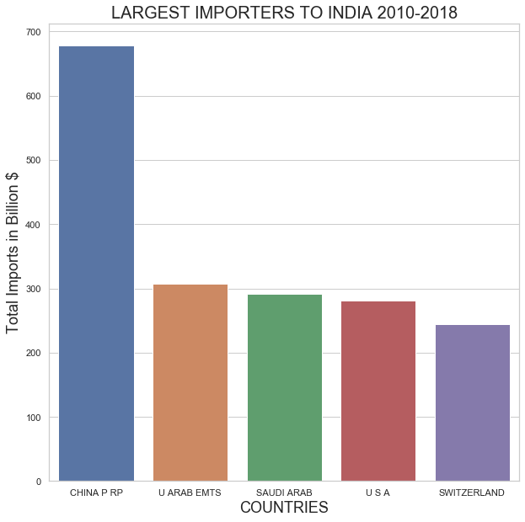
Results: Largest Importers to India from 2010 to 2018
This graph shows the largest imports to India from 2010 to 2018.this includes the comparison of countries and total imports(in billions).
This shows that CHINA is the largest Importer To India from almost a Decade

Slide 6
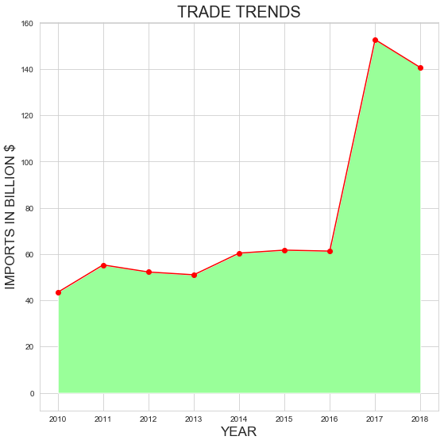
CHINA P RP
Graph shows there was gradual increase in imports from china but a sudden and healthy increase in Imports to India from CHINA was reported in year 2016-2017

Slide 7
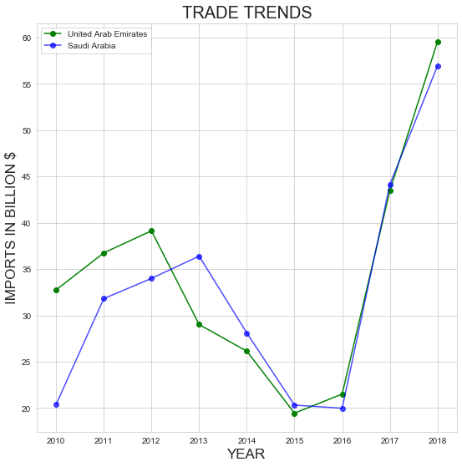
United ARAB EMTS & SAUDI ARABIA
After plotting for Top3 Importers it was found that there is continuous increase in import from China since year 2010 but on other hand there was a decline in imports from Arab countries mainly UAE and SAUDI ARABIA till 2016 and then a whooping increase was noticed

Slide 8
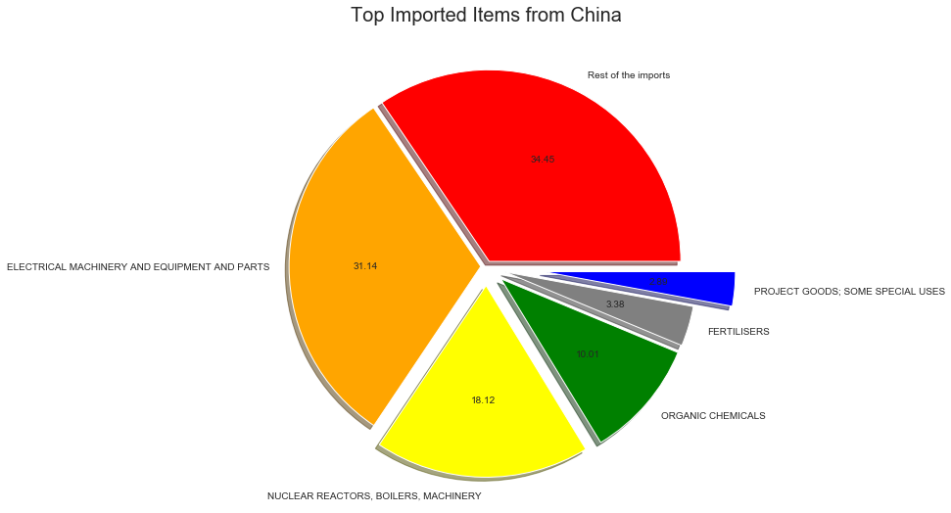
Details About Largest Importer To India
This shows ELECTRICAL MACHINERY AND EQUIPMENT were the Items that Dominated the imports from CHINA to India from 2010-2018

Slide 9
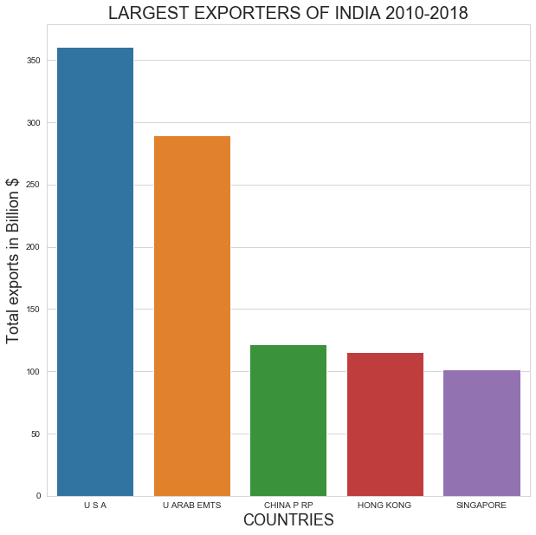
LARGEST EXPORTERS OF INDIA 2010-2018
This shows USA is the largest Importer of INDIAN product and service

Slide 10
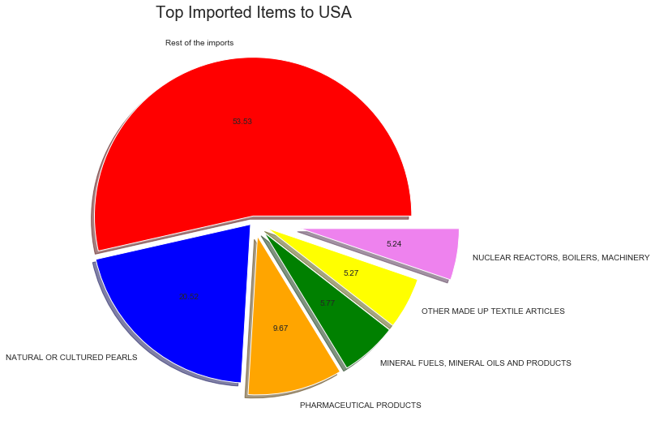
Details for Largest Importer of Indian goods and services
This shows that Indian Natural/Cultured Pearls are in great Demand In USA

Slide 11
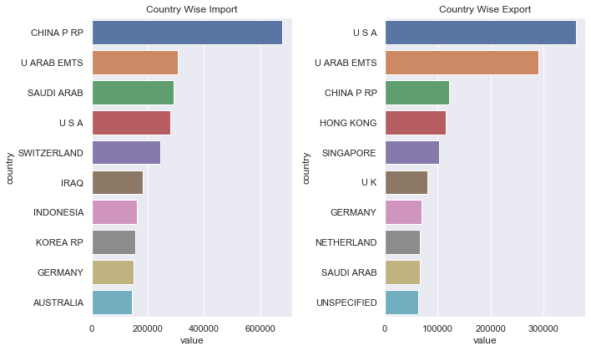
Import And Export Country Wise
China has biggest market in India followed by UAE , Saudi Arabia and USA
USA is our biggest importer followed by UAE and China Republic.
Trade Deficit/Surplus Top 5 country
China - very Huge Trade Deficit
UAE - little Trade Surplus
Saudi Arabia- Huge Trade Deficit
USA - little Trade Surplus
Switzerland - not making even in the top export graph showing sign of Huge Trade Deficit.

Slide 12
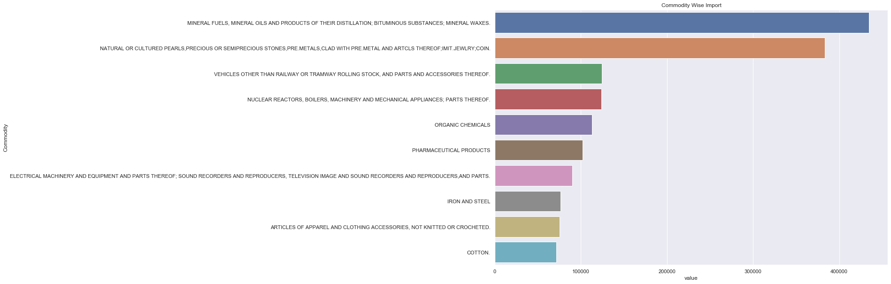

Slide 13
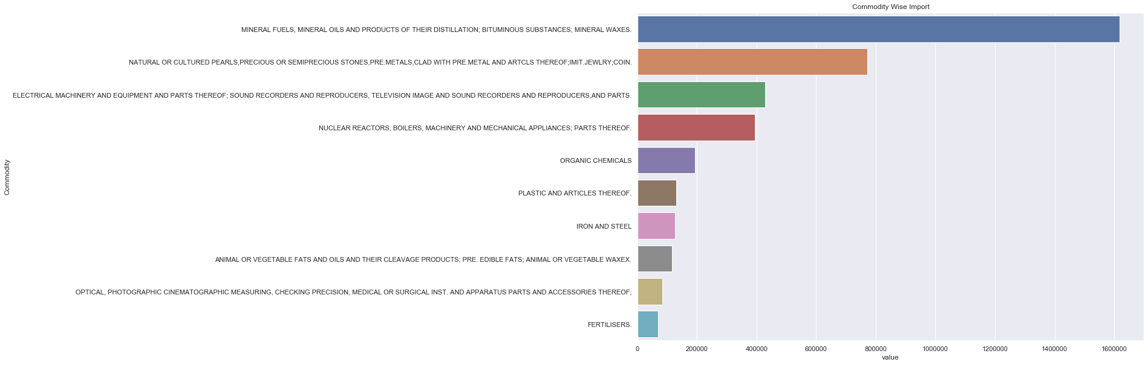
Top exported categories are also the top imported categories but there is huge trade deficit category wise.
Vehicle Other Than railway...and Pharmaceutical product HScode Chapters shows a trade surplus

Slide 14
Conclusion and Future plan
Need of the Hour is to reduce the trade deficit
New Initiative taken by Government as "Skill India" , "Make In India", "Startup India" can help to boost the Export if the work is implemented on ground reality.
Bilateral ties between countries helps to reduce export duty which help the local company compete in global market.
As India Primarily is a Agricultural Country training and Guiding and providing export quality crops/medicinal plant can help to boost agricultural export.
A trade deficit is an economic measure of international trade in which a country's imports exceed its exports.
Trade Deficit = Total Value of Imports – Total Value of Exports Trade deficit is not always negative because :-
When production cannot meet demand, imports from other nations increase. A trade deficit is not necessarily detrimental, because it often corrects itself over time. An increase in imported goods from other countries decreases the price of consumer goods in the nation, as foreign competition increases. The lower price tags help reduce the threat of inflation in the local economy, and an increase in imports also increases the variety of goods and services available to a nation’s residents. A fast-growing economy might import more, as it expands, so its residents may consume more than the country can produce. Consequently, a trade deficit may indicate a growing economy.
Problems of Trade deficit
In the long run, however, a trade deficit may lead to fewer jobs. If the country is importing more goods from foreign companies, prices will decline, and domestic companies may be unable to produce items that compete with lower costs. Manufacturing companies are usually hit the hardest when a country imports more than it exports. This impact results in fewer jobs or lower incomes for employees, due to the competition from imports. Fewer jobs mean fewer products are produced in the economy which, in turn, leads to even more imports and a greater deficit.
Real World Example
The U.S. holds the distinction of owning the world's largest trade deficit since 1975. In 2013, the deficit in goods and services was more than $472 billion, mainly because the country imported and consumed significantly more electronics, raw materials, oil, and other items than it sold to foreign countries.

Slide 15
I ever Grateful to you Manjit Singh sir and Raja Subramanyam sir for giving the present project as I improved my self in coding better than before.

